Slide 1

Weekly Review
01/06/21
Tasks
Memory gets saturated in Stable Baselines implementation problem - ✔
Run and log stable baselines implementation - ✔
Problems
To-Do Items for Next Week
Get results using cloth_corner with stable baselines implementation
Get results using cloth_sewts_exp with stable baselines implementation

Slide 2
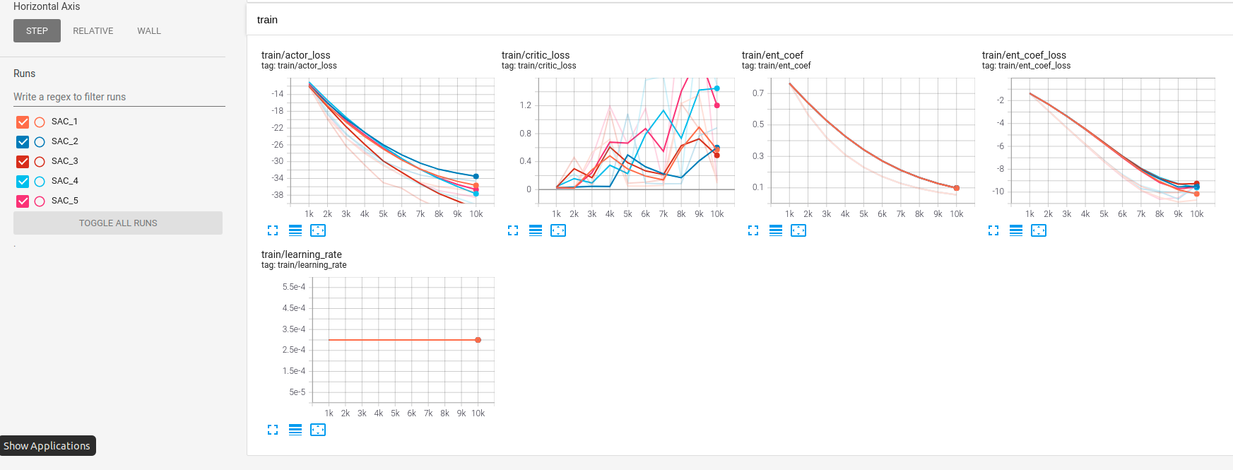
Weekly Review
01/06/21

Slide 3
THANK YOU

